Slide 1
Welcome

Slide 2
Aims of the workshop
The main aims of this workshop are to:
Inform parents about phonics and the phonics screening test in year 1;
Inform parents of the new curriculum expectations for grammar, punctuation and spelling for key stage 1 (year 1 and year 2);
Provide an overview of new assessments of SPAG for Year 2;
Offer ideas about how you can support your child in their writing at home.

Slide 3
Year 1 Reading expectations
By the end of year 1 children should be:
Reading many high frequency words by sight.
Using their phonics to decode unfamiliar words.
Taking account of punctuation and reading with expression.
They should also have a basic understanding of what they are reading and be able to say what has happened in a story they have read.

Slide 4
Year 1 writing expectations
By the end of year 1 it would be expected that children should be:
Writing several simple sentences, e.g. Sam waited for the train.
Beginning to use capital letters and full stops in the correct places.
Spelling the majority of high frequency/ tricky words correctly.
Able to write for several different purposes, e.g. story writing, non-fiction (report, recount) poetry.

Slide 5
Year 1 Phonics
What is phonics?
Phonics is a way of teaching children to read quickly and skilfully. Children are taught how to recognise the sounds each individual letter makes and to identify the sounds that different combinations of letters make such as ‘sh’ and ‘oo’.
Children are taught to read by breaking down words into separate sounds or ‘phonemes’. They are then taught how to blend these sounds together to read the whole word.
We teach phonics following the letters and sounds programme. This is also supported by the Jolly phonics programme.
Articulation of Phonemes – YouTube
https://www.youtube.com/watch?v=eCjJYB07aSU - Jolly Phonics songs.

Slide 6
What is the phonics screening check?
The National phonics screening check is a statutory assessment that was introduced in 2012 to all year 1 pupils and is a quick and easy check of the children’s phonics knowledge.
All year 1 pupils will take the phonics screening check in 2016 during the week beginning 13th June.

Slide 7
What is in the phonics screening check?
It comprises of a list of 40 words and nonsense words.
It will assess phonics skills and knowledge learnt through reception and year 1.
Your child will read one to one with their teacher.
Your child will read up to 4 words per page and the check will take around 15 minutes.
They will be asked to ‘sound out’ a word and blend the sounds together. The check is very similar to tasks the children already compete during phonics lessons.

Slide 8
What are nonsense words and why are they included?
These are words that are phonetically decodable but are not actual words with an associated meaning e.g. brip, snorb.
These words are included in the check specifically to assess whether children can decode a word using phonic skills and not their memory.
The nonsense words will be shown to the children with a picture of an alien.

Slide 9
How will the results from the screening be used?
You will be informed of how your child has done in the screening check, towards the end of the summer term.
The screening check will identify children who have phonic decoding skills below the level expected for the end of year 1 and who therefore need help. Children will then retake the assessment in year 2.

Slide 10
How can I help my child?
There are a number of things that parents can do to support early reading development:
Let your child see you enjoy reading yourself. They are influenced by you and what you do!
Encourage your child to read anywhere and anything – signs, packaging labels, cereal boxes, magazines, websites.
Make time for your child to read their school book to you.
With all books, encourage your child to ‘sound out’ unfamiliar words and then blend from left to right rather than looking at pictures to guess.

Slide 11
Useful websites
www.phonicsplay.co.uk
http://www.letters-and-sounds.com
http://www.ictgames.com/literacy.html
-
https://www.youtube.com/watch?v=BqhXUW_v-1s link for phonics pronunciation video
https://www.youtube.com/watch?v=eCjJYB07aSU - Jolly Phonics songs.

Slide 12
Spelling, Punctuation & Grammar
Key Stage 1

Slide 13
What’s changed in the new curriculum?
The revised National Curriculum for English (introduced from September 2014) places a much stronger emphasis on vocabulary development, grammar, punctuation and spelling
Expectations have been raised in each year group with many aspects having to be taught at least a year earlier than in the previous curriculum (for example, the use of commas and apostrophes will be taught in KS1)
Pupils are expected to recognise and use the grammatical terminology appropriate to their year group
Notes:
In 2012, Mr Gove introduced the SPAG test. “…we want to make sure that when children leave primary school they are confident in grammar, punctuation and spelling. The test will ensure that primary schools place a stronger focus on the teaching of these skills than in previous years.”
The new curriculum expects children to tackle more challenging grammar earlier on, for example subordination and co-ordination is now in year 2 when it used to be in year 4. We will share the expectations for both year 1 and 2 in the next two slides.
The terminology will also be shared in further slides and we have prepared a booklet for you to take away and use/look at at home.

Slide 14
New curriculum expectations - Year 1
Regular plural noun suffixes e.g. -s and –es
Suffixes and prefixes e.g. –ing, -ed, -er and un-
Connectives e.g. and
Capital letters, full stops, question marks and exclamation marks
Capital letters for names and for the personal pronoun I
Notes:
Although this is set out as the expectation for year 1 many of these objectives will still be applicable for children in year 2 as they need to practise these areas to maintain their understanding.

Slide 15
New curriculum expectations - Year 2
Nouns using suffixes e.g. –ness, and –er
Adjectives using suffixes e.g. –ful and –less
Adverbs by adding e.g. –ly
Subordination and coordination e.g. when, if, that, because and or: and, but
Expanded Noun Phrase e.g, the blue butterfly, plain flour, the man in the moon
Sentences with different forms e.g. statement, question, exclamation or command
Present/Past/Continuous tense
Capital letters, full stops, question marks, exclamation marks, commas and apostrophes.

Slide 16
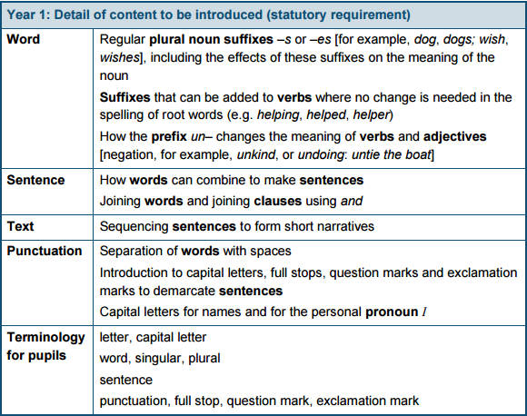
Vocabulary, Punctuation and Grammar Year 1 Curriculum Outline

Slide 17
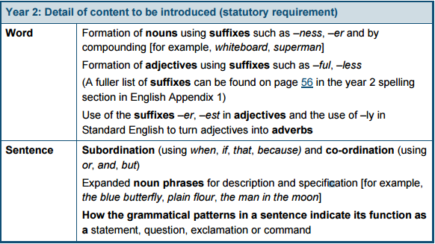
Vocabulary, Punctuation and Grammar Year 2 Curriculum Outline

Slide 18
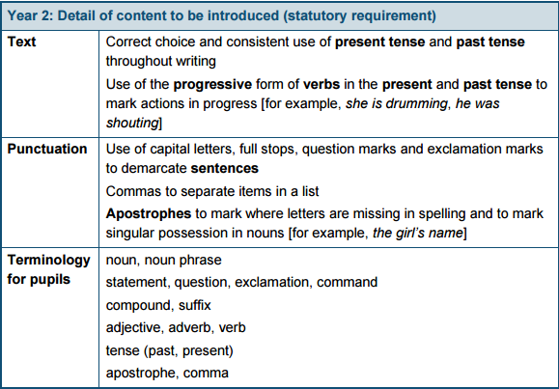
Vocabulary, Punctuation and Grammar Year 2 Curriculum Outline
Notes:
All of this has been included in a KS1 booklet for parents to take home and refer to, if they wish. The booklet outlines expectations for year 1 and 2 so that parents in year 2 are able to refer back to year 1 expectations and year 1 parents can gain an overview of what children will cover in year 2. (There is lower KS2 booklet available with year 3 expectations too.)
There is also a grammar terminology glossary booklet for Key Stage 1 which explains many of the terms we use at school and within lessons. Please feel free to take a copy.

Slide 19
Spellings
Spelling – example of work for year 1
Statutory requirements |  | Rules and guidance (non‑statutory) | Example words (non‑statutory)
The sounds /f/, /l/, /s/, /z/ and /k/ spelt ff, ll, ss, zz and ck |  | The /f/, /l/, /s/, /z/ and /k/ sounds are usually spelt as ff, ll, ss, zz and ck if they come straight after a single vowel letter in short words. Exceptions: if, pal, us, bus, yes. | off, well, miss, buzz, back
The /ŋ/ sound spelt n before k |  |  | bank, think, honk, sunk
Division of words into syllables |  | Each syllable is like a ‘beat’ in the spoken word. Words of more than one syllable often have an unstressed syllable in which the vowel sound is unclear. | pocket, rabbit, carrot, thunder, sunset

Slide 20
Spellings
Spelling – example of work for year 2
Statutory requirements |  | Rules and guidance (non‑statutory) | Example words (non‑statutory)
The /dʒ/ sound spelt as ge and dge at the end of words, and sometimes spelt as g elsewhere in words before e, i and y |  | The letter j is never used for the /dʒ/ sound at the end of English words. At the end of a word, the /dʒ/ sound is spelt –dge straight after the /æ/, /ɛ/, /ɪ/, /ɒ/, /ʌ/ and /ʊ/ sounds (sometimes called ‘short’ vowels). After all other sounds, whether vowels or consonants, the /dʒ/ sound is spelt as –ge at the end of a word. In other positions in words, the /dʒ/ sound is often (but not always) spelt as g before e, i, and y. The /dʒ/ sound is always spelt as j before a, o and u. | badge, edge, bridge, dodge, fudge age, huge, change, charge, bulge, village gem, giant, magic, giraffe, energy jacket, jar, jog, join, adjust
The /s/ sound spelt c before e, i and y |  |  | race, ice, cell, city, fancy
The /n/ sound spelt kn and (less often) gn at the beginning of words |  | The ‘k’ and ‘g’ at the beginning of these words was sounded hundreds of years ago. | knock, know, knee, gnat, gnaw
The /r/ sound spelt wr at the beginning of words |  | This spelling probably also reflects an old pronunciation. | write, written, wrote, wrong, wrap
The /l/ or /əl/ sound spelt –le at the end of words |  | The –le spelling is the most common spelling for this sound at the end of words. | table, apple, bottle, little, middle

Slide 21
Assessment changes - 2016
In line with the new raised expectations, there will be new national curriculum tests for grammar, punctuation and spellings in Years 2 and 6 introduced in 2016.
The year 2 tests are due to take place in May of each year.
The test consists of two separate papers:
Paper 1: spelling (20 marks)
Paper 2: questions (20 marks)

Slide 22
Spelling, Punctuation and Grammar Tests KS1

Slide 23
Spelling, Punctuation and Grammar Tests KS1

Slide 24
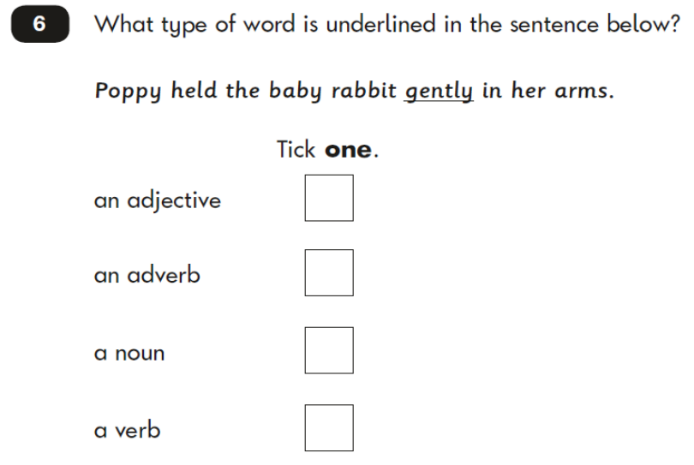
Spelling, Punctuation and Grammar Tests KS1

Slide 25
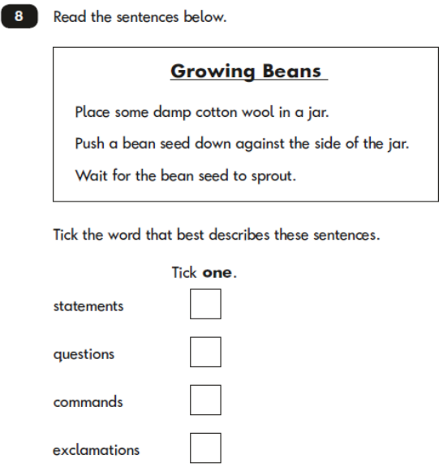
Spelling, Punctuation and Grammar Tests KS1

Slide 26
Spelling, Punctuation and Grammar Tests KS1

Slide 27
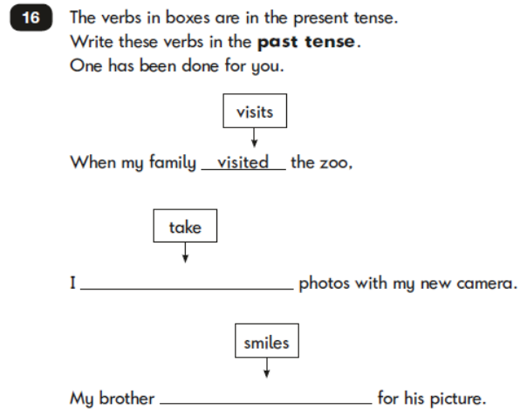
Spelling, Punctuation and Grammar Tests KS1

Slide 28
What do we do at school to improve writing?
• Grammar and punctuation are explicitly taught and practised in English lessons, and then applied in the children’s own writing.
• Spelling patterns and general rules are taught and practised with weekly spelling tests.
• Regular opportunities to write at length (including the ‘Big Write’) and ongoing teacher assessment of writing.
• Children’s individual writing targets.
• Writing skills applied across the Curriculum (e.g. RE, Topic, Science).
Notes:
We focus on spelling, punctuation and vocabulary skills during our literacy starters e.g. adjectives, verbs, full stops, commas for a list, writing descriptive sentences, games, etc.
We also teach discrete SPAG lessons in year 2 two to three times a week in 30 minute afternoon sessions. We try to keep these activities fun and enjoyable for the children, often playing games and using table top activities as well as introducing children to the format that they will face in the KS1 SATs paper.

Slide 29
How can you help at home?
http://www.oxfordowl.co.uk/ - This website has lots of ideas for quick and easy ways to help your child with grammar, punctuation and spelling, plus games and activities you can play with your child to support their learning. There is also a great selection of videos to support parents in their understanding of grammar.
Practise and learn weekly spelling lists – make it fun!
Encourage opportunities for writing, such as letters to family or friends, shopping lists, stories or poems.
Write together – be a good role model for writing.
Encourage use of a dictionary to check spelling.

Slide 30
How can you help at home?
Continued:
Remember that good readers become good writers! Identify writing features when reading (e.g. vocabulary, sentence structure, punctuation).
Show your appreciation: praise and encourage, even for small successes!
Be positive!

Slide 31
Useful Websites
Fun English Games:
http://www.funenglishgames.com/grammargames.html
BBC Bitesize:
http://www.bbc.co.uk/bitesize/ks1/literacy/

Slide 32
Questions?

