Slide 1

Welcome
Key Stage 2 Parent Workshop: English

Slide 2
Aims of the workshop
The main aims of this workshop are to:
Inform parents of the current curriculum expectations for grammar, punctuation and spelling for key stage 2 (years 3 -6)
Inform parents about how we are approaching writing composition in the school
Provide an overview of end of key stage assessments for English
Offer ideas about how you can support and encourage your child in their reading and writing at home.

Slide 3
Spelling, Punctuation & Grammar
Key Stage 2

Slide 4
What’s changed in the new curriculum?
The revised National Curriculum for English (introduced from September 2014) places a much stronger emphasis on vocabulary development, grammar, punctuation and spelling
Expectations have been raised in each year group with many aspects having to be taught at least a year earlier than in the previous curriculum
Pupils are expected to recognise and use the grammatical terminology appropriate to their year group in their writing
Notes:
In 2012, Mr Gove introduced the SPAG test. “…we want to make sure that when children leave primary school they are confident in grammar, punctuation and spelling. The test will ensure that primary schools place a stronger focus on the teaching of these skills than in previous years.”
The new curriculum expects children to tackle more challenging grammar earlier on, for example subordination and co-ordination is now in year 2 when it used to be in year 4.
The terminology will also be shared in further slides and we have prepared a booklet for you to take away and use/look at home.

Slide 5
New curriculum expectations - Year 3
• Formation of nouns using a range of prefixes e.g. super–, anti–,
auto–
• Use of the forms ‘a or an’ according to the next word
• Word families based on common words, showing how words are
related in form and meaning e.g. solve, solution, solver, dissolve,
insoluble
• Expressing time, place and cause using conjunctions e.g. when,
adverbs e.g. soon or prepositions e.g. before
• Introduction to paragraphs, headings and sub-headings to aid
presentation
• Use of the present perfect form of verbs instead of the simple past
e.g. He has gone out to play contrasted with He went out to play
• Inverted commas to punctuate direct speech
Notes:
These slides contain some of the statutory objectives for each year group and are detailed in the handout – KS2 Vocabulary, Grammar and Punctuation Progression.
Note: There is now the expectation that to be ‘on track’ in writing (ARE) your child should be using their year group expectations as well as all previous year group levels.

Slide 6
New curriculum expectations - Year 4
• Plural and possessive –s
• Standard English forms for verb inflections instead of local spoken
forms e.g. we were instead of we was
• Noun phrases expanded by the addition of modifying adjectives,
nouns and preposition phrases e.g. the teacher expanded to: the strict maths teacher with curly hair
• Fronted adverbials e.g. Later that day, I heard the bad news.
• Use of inverted commas and other punctuation to indicate direct
speech
• Apostrophes to mark plural possession e.g. the girl’s name versus the girls’ name
• Use of commas after fronted adverbials

Slide 7
New curriculum expectations - Year 5
• Converting nouns or adjectives into verbs using suffixes e.g.–ate; –ise; –ify
• Verb prefixes e.g. dis–, de–, mis–, over– and re–
• Relative clauses beginning with who, which, where, when, whose, that,
or an omitted relative pronoun
• Indicating degrees of possibility using adverbs e.g. perhaps or modal
verbs e.g. might
• Devices to build cohesion within a paragraph e.g. then
• Linking ideas across paragraphs using adverbials of time e.g. later, place
e.g. nearby and number e.g. secondly or tense choices e.g. he had seen
her before
• Brackets, dashes or commas to indicate parenthesis
• Use of commas to clarify meaning or avoid ambiguity

Slide 8
New curriculum expectations - Year 6
• Use of the passive to affect the presentation of information in a
sentence e.g. I broke the window in the greenhouse versus The
window in the greenhouse was broken
• Use of subjunctive forms such as If I were or Were they to come in
some very formal writing and speech
• A wider range of cohesive devices: repetition of a word or phrase,
grammatical connections e.g. the use of adverbials such as on the
other hand and ellipsis
• Use of the semi-colon, colon and dash to mark the boundary between
independent clauses e.g. It’s raining; I’m fed up, use of the colon to
introduce a list and use of semi-colons within lists and how hyphens
can be used to avoid ambiguity recover versus re-cover
• Punctuation of bullet points to list information

Slide 9
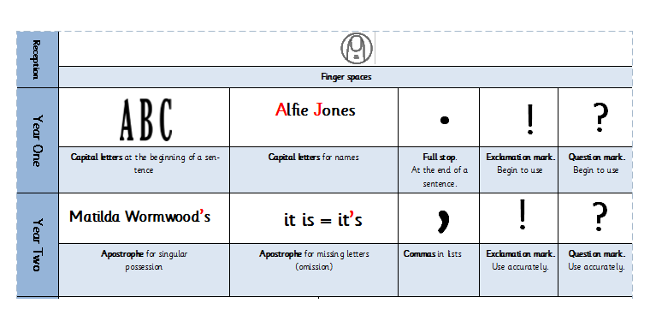
Punctuation Progression Key Stage 1
Notes:
Often we are still reminding children all the way through KS2 about CL and FS rules. As you can see it is expected that these skills are at a Y1 level. If children are still omitting the basics it is clearly much harder for them to be ‘on track’.

Slide 10
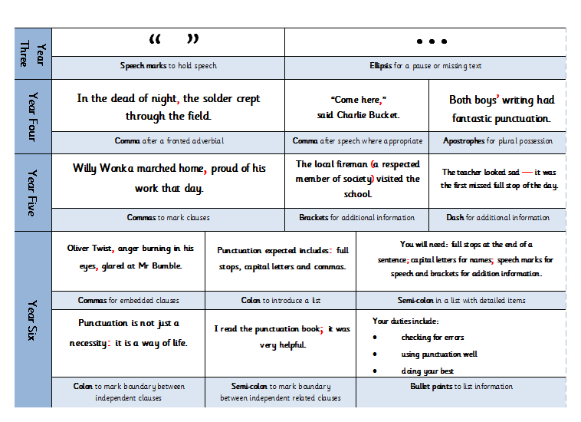
Punctuation Progression Key Stage 2

Slide 11
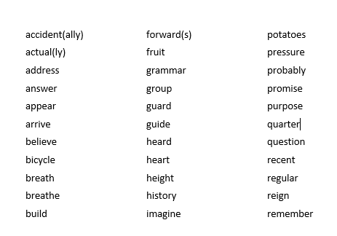
Spellings: Year 3 & 4
Notes:
There is similarly a heightened expectation of spelling. See handouts for particular spelling rules etc taught in each year group.

Slide 12
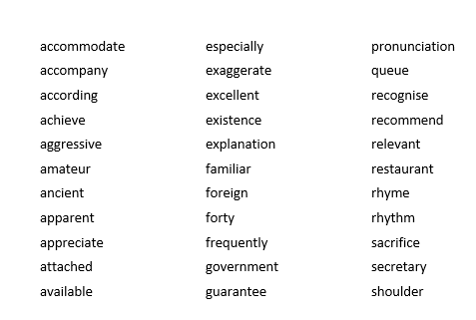
Spellings: Year 5 & 6

Slide 13
Writing Composition
Within the new curriculum, there are no set genres that must be taught in each year group. As a school, we have decided how genres are distributed to ensure progression of skills e.g. each year group covers narrative writing and information writing.
Skills such as development of vocabulary, creating atmosphere, considering an audience, paragraph use and editing draft work are developed across the key stage.
Years 3 – 5 teachers will make an end of year judgement for each child based on key objectives for their year group.
Year 6 have been issued with a government produced ‘Interim Framework’ of assessment to be used this year. Children must achieve ALL bullet points to be assessed as working at the expected standard.

Slide 14
Year 6 Writing Expectations
Working at the expected standard
The pupil can write for a range of purposes and audiences (including writing a short story):
• creating atmosphere, and integrating dialogue to convey character and advance
the action
• selecting vocabulary and grammatical structures that reflect the level of formality
required mostly correctly
• using a range of cohesive devices*, including adverbials, within and across sentences
and paragraphs
• using passive and modal verbs mostly appropriately
• using a wide range of clause structures, sometimes varying their position within the
sentence
• using adverbs, preposition phrases and expanded noun phrases effectively to add
detail, qualification and precision
• using inverted commas, commas for clarity, and punctuation for parenthesis mostly
correctly, and making some correct use of semi-colons, dashes, colons and hyphens
• spelling most words correctly* (years 5 and 6)
• maintaining legibility, fluency and speed in handwriting through choosing whether
or not to join specific letters.

Slide 15



How we teach writing
Scaffolded Writing
Independent Big Write (assessment)
Free Choice Independent (assessment)
Proof-reading and editing

Slide 16
What do we do at school to improve writing?
• Grammar and punctuation are explicitly taught and practised in English lessons, and then applied in the children’s own writing.
• Spelling patterns and general rules are taught and practised often with weekly spelling tests.
• Regular opportunities to write at length (including the ‘Big Write’) and ongoing teacher assessment of writing.
• Children’s individual writing targets.
• Writing skills applied across the Curriculum (e.g. RE, Topic, Science).
Notes:
Y5/6 discreet SPaG sessions

Slide 17
Assessment changes - 2016
Assessment changes – 2016
At the end of Key Stage 2 (Year 6), there are 3 tests for English. These are: Reading, Spelling and Punctuation & Grammar.
• In line with the raised expectations, these tests are at the new curriculum level and will be sat for the first time in May 2016.
• For your child to do well in the SPaG tests, they don’t
just have to be good at writing; they also need a technical
understanding of how the English language works,
including the correct grammatical terminology.
Writing is assessed by the class teacher and not covered by a test.
Notes:
The English grammar, punctuation and spelling test was
introduced in May 2013 as part of the KS2 SATs
programme for Year 6 pupils, replacing the previous
English writing test.

Slide 18
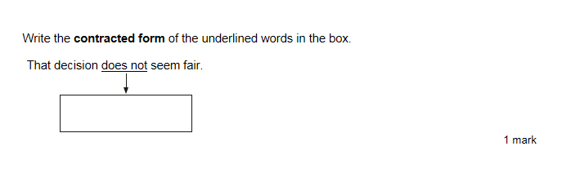
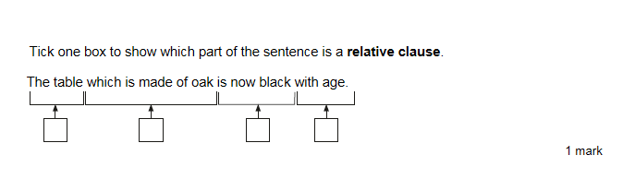
Punctuation and Grammar Test
Notes:
Sample questions

Slide 19
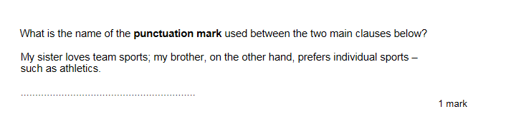
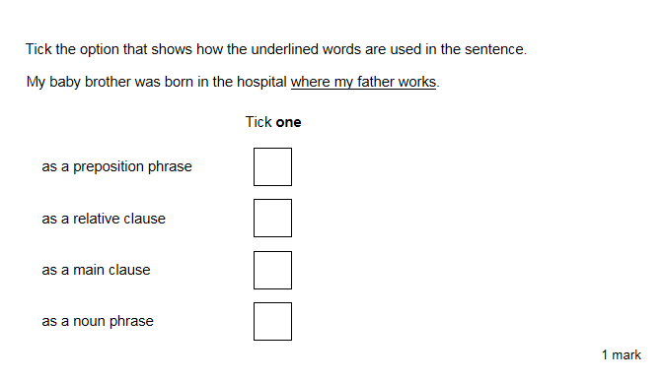
Punctuation and Grammar Test
Notes:
Sample questions

Slide 20
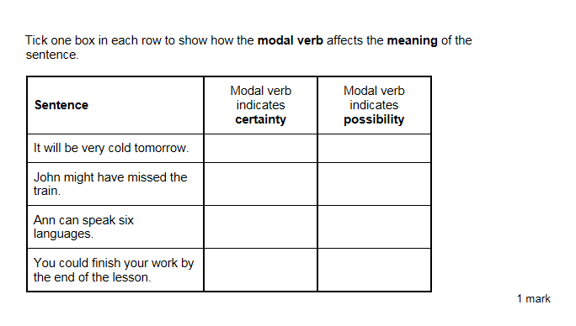
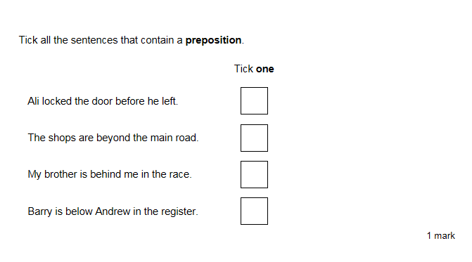
Punctuation and Grammar Test
Notes:
Sample questions

Slide 21
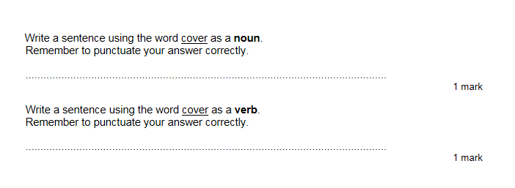
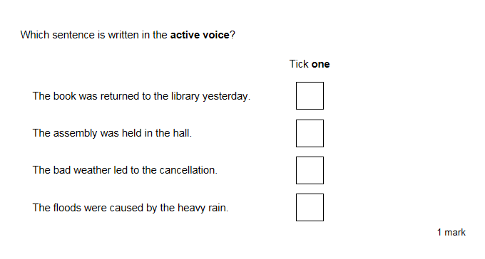
Punctuation and Grammar Test
Notes:
Sample questions

Slide 22
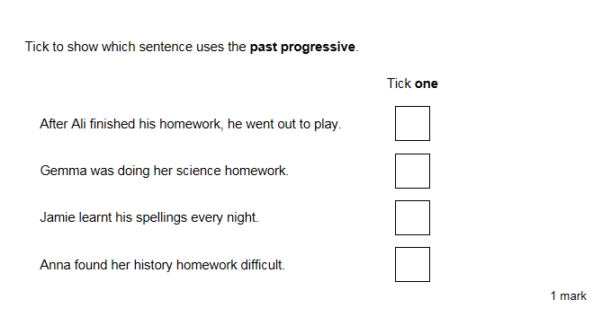
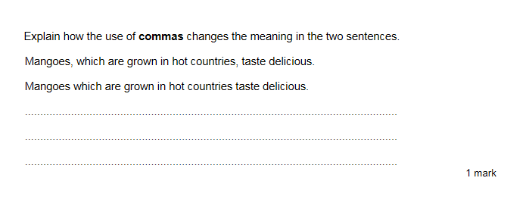
Punctuation and Grammar Test
Notes:
Sample questions

Slide 23
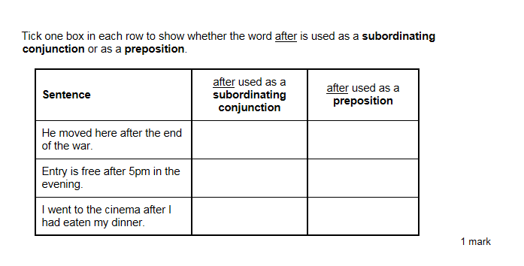
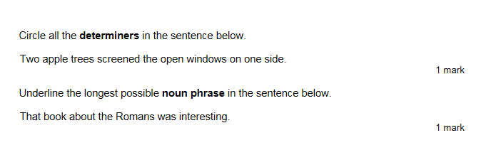
Punctuation and Grammar Test
Notes:
Sample questions

Slide 24
How can you help at home?
Practise and learn weekly spelling lists – make it fun!
Encourage opportunities for writing, such as letters to family or friends, shopping lists, stories or poems.
Write together – be a good role model for writing.
Encourage use of a dictionary to check spelling and a thesaurus to extend vocabulary.

Slide 25
How can you help at home?
Continued:
Remember that good readers become good writers! Identify writing features when reading (e.g. vocabulary, sentence structure, punctuation).
Ask comprehension questions to check understanding of vocabulary.
Show your appreciation: praise and encourage, even for small successes!
Be positive!

Slide 26
Useful Websites
Fun English Games:
http://www.funenglishgames.com/grammargames.html
http://www.topmarks.co.uk/
http://resources.woodlands-junior.kent.sch.uk/interactive/literacy2.htm
BBC Bitesize:
http://www.bbc.co.uk/bitesize/ks2/english/spelling_grammar/

Slide 27
Questions?

