Slide 1
Key Information
for 2023-24
Year 1 - 6

Slide 2
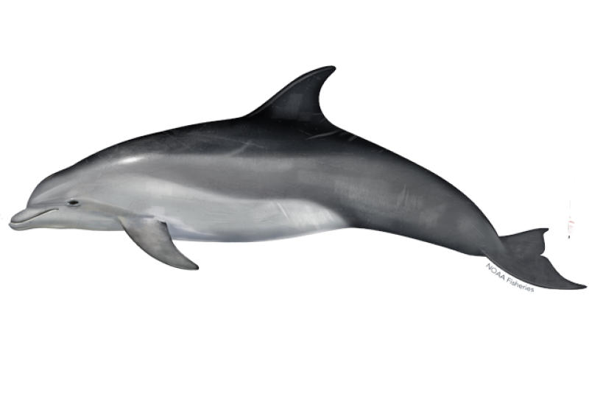
Year 1 Dusky Dolphins and Spinner Dolphins
PE days - Tuesday and Friday
Please ensure that children have their kit with them and that all items are clearly labelled.
Topics
1. There’s No Place Like Home 2. On The Move 3. Knights and Castles
-
-
Dusky Dolphins
Monday- Miss Gallagher
Tuesday- Mrs Westcott
Wednesday Miss Gallagher am Mrs Westcott pm
Thursday- Miss Gallagher
Friday- Miss Gallagher
Spinner Dolphins
Monday - Friday - Mrs Crawford
Wednesday - Ms Cleaver pm

Slide 3
Year 2 Penguins and Puffins
Penguin Teachers: Ms Cleaver (Monday-Tuesday) and Mrs MacDonald (Wednesday, Thursday & Friday)
Puffin Teacher: Miss Sinden
Thursday afternoon the children will have Mrs Gullick for P.E and Mrs Backshall Wilkinson (Computing)
PE days: Penguins - Wednesday & Thursday.
Puffins- Monday & Thursday.
Please ensure that children have their kit with them and that all items are clearly labelled.
Topics: Autumn Term - Great Fire of London and Polar Regions, Spring - Explorers, Summer - Seaside
Homelearning: Set on a Thursday on Google Classroom and due in by the following Thursday.

Slide 4
Year 3 Seals and Sea Lions
Seals Teacher: Mr MacAllister
Sea Lions Teachers: Miss Christy (Monday - Wednesday) Miss Wells (Thursday - Friday) The children will have Mrs Bridle for Computing and Mrs Ellis for Music
PE days: Seals - Wednesday & Friday.
Sea Lions - Wednesday and Thursday.
Swimming will take place on a Thursday in the Summer Term.
Please ensure that children have their kit with them and that all items are clearly labelled.
Topics: Autumn Term - Victorians, Spring - The Rainforest, Summer - Romans in Britain
Homelearning: Set on a Friday on Google Classroom and due in by the following Thursday.

Slide 5
Year 4 Seahorses and Sea Otters
Seahorses Teachers: Miss Goss (Monday-Wednesday) and Mrs Batchelor (Thursday & Friday)
Sea Otter Teacher: Mrs Bannier
Wednesday mornings (whilst the year 4 team are planning the week) the children will have Miss Wells (PE) and Mrs Ellis (Music)
PE days: Seahorses - Wednesday & Friday.
Sea Otters - Wednesday & Thursday.
Please ensure that children have their kit with them and that all items are clearly labelled
Swimming will take place on a Thursday in the Spring Term.
Topics: Autumn Term - Ancient Egyptians, Spring - Great Barrier Reef, Summer - Tudors
Homelearning: Set on a Friday on Google Classroom and due in by the following Friday.

Slide 6
Year 5
Trips/visits
Autumn: Rainbow theatre, Applesham farm (harvest)
Spring: River walk, Applesham farm (lambing)
Summer: Truleigh Hill, Applesham (insects and flowers)
Mr Davies (Turtles)
Miss Smith (Terrapins)
Mrs Backshall (Y5 TA)
PE days
Thursday (swimming kit)
Friday (PE kit)
Topics
Autumn: Ancient Greeks
Spring: Mountains & Rivers
Summer: Anglo Saxons & Vikings
Home learning (google classroom)
xTables and reading daily
Maths booklets as needed
Creative tasks over holidays
Weekly homework starts in Summer term
Fridays Children will be taught by Ms Cleaver and Mrs Ellis in the morning.

Slide 7
Year 6 Coral and Oyster
Oyster: Mrs Stenning (Tuesday-Friday) and Mrs Woodman (Monday)
Coral: Mr de Waal
Thursday mornings (whilst the year 6 team are planning the week) the children will have Mr Lincoln and _______
Music will be taught by Mrs Ellis
PE days: Monday and Thursday
Please ensure that children have their kit with them and that all items are clearly labelled.
Topics: Autumn Term - WWll, Spring - India, Summer - Prehistory
Homelearning: Set on a Friday on Google Classroom and due in by the following Friday.
Year 6 children have lots of responsibilities throughout the year including peer mediating, hall duties, sports crew etc. They will be expected to be role models for the school.
We will have meetings about both SATs and Dalesdown (residential) later on in the year but please feel free to speak to us about any issues or questions that arise.

