Slide 1


A Guide to Accelerated Reader
for Parents and Carers

Slide 2

What is Accelerated Reader?
Accelerated Reader is an exciting reading system for children in Year 2 and Key Stage 2.
Effective system for motivating children to read and supporting good reading progress.
  Helps teachers manage and monitor children’s reading practice.

Slide 3
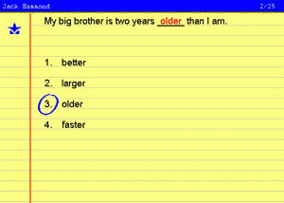
How does Accelerated Reader work?
STEP 1: AR determines the level of your child’s reading.
How does this happen?
Your child takes a STAR Reading test
What is a STAR Reading test?
At the beginning of the academic year, your child will take a STAR Reading test.
Children answer questions with multiple choice answers about a short text read on a computer.
Questions continually adjust to your child’s responses.
Eg. If your child’s response is correct, the difficulty level is increased and vice versa.
Children will re-take the test once they have met their target.

Slide 4
How does Accelerated Reader work?
STEP 2:
A report is produced on the STAR Reading test which enables the appropriate book level to be set for your child.
Your child will be given a book level range with texts which will challenge and motivate their reading.
Try an Accelerated Reader quiz on the link below.
http://www.renlearn.co.uk/accelerated-reader/sample-quizzes/

Slide 5

What happens to the results from the quiz?
Accelerated Reader gives both children and teachers feedback based on the quiz results.
The school then uses this feedback to set reading targets and support ongoing reading practice.
Teachers also do their own assessment through individual and guided reading sessions.
Staff may assist your child by:
helping choose another book that is more appropriate.
asking probing questions as your child reads and before quizzing.
sitting with your child whilst they are taking the quiz. Are they rushing?

Slide 6



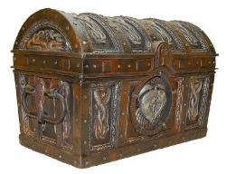


Reward system
Everytime your child attains 100% in a quiz they get a lucky book token.
Every child is set a target number of reading points to earn.
Individual targets are set by Mrs Kennard with the input of class teachers.
The target is designed to be motivational and to ensure enough reading practice is happening to
guarantee progress.
Your child’s target can be found on their AR book mark.
EXAMPLE:
Target is: 60 points
Pizza Party!
100% 60 points
75% 45 points
50% 30 points
25% 15 points
Rockin’ Reader Treasure Chest Prize!

Slide 7
How many Accelerated Reader quizzes are there?
How will I know if a book has an AR quiz?
There are several ways of achieving this. Your child can bring a book into school, log in to the system and search for the quiz.
Alternatively, the AR Book Finder service available at www.arbookfind.co.uk allows you to search all available books with AR quizzes.

Slide 8
More information…
Information on our school website
Contact your child’s class teacher
Mrs Kennard and Mrs Bishop can also answer more general questions about Accelerated Reader.
Look at the Accelerated Reader website: www.renlearn.co.uk

Slide 9

Points and Accelerated Reader can be motivational but…
…the most important thing is for reading and books to be enjoyable for your child.
"If we don't learn to love books, we don't read.
And if we don't read widely, we don't think deeply.”
Michael Rosen
Please still help your child read unknown words in their AR book. Your child does not have to read the book entirely independently if this reduces their enjoyment of reading.
Michael Rosen has some fantastic ideas about making reading FUN!
https://www.youtube.com/watch?v=dv2VUyR0X8M

