Slide 1


In September I will be going to St Nicolas and St Mary
Primary School.
I will be in Blue whales class.

Slide 2
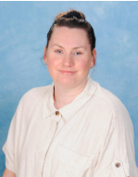
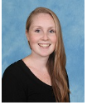
My Class Teachers will be...
Mrs Allier
Mrs Wren

Slide 3
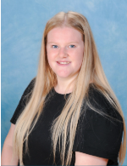
This is my Teaching Assistant.
Miss Simmons

Slide 4
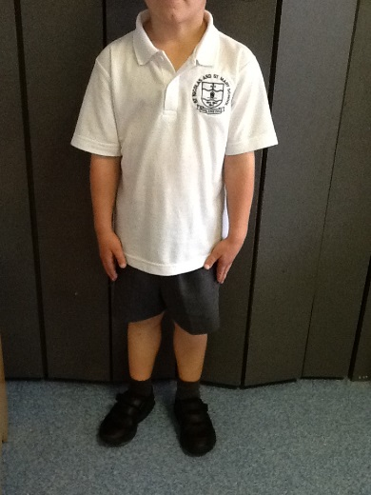
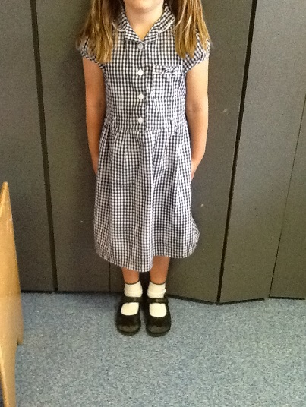
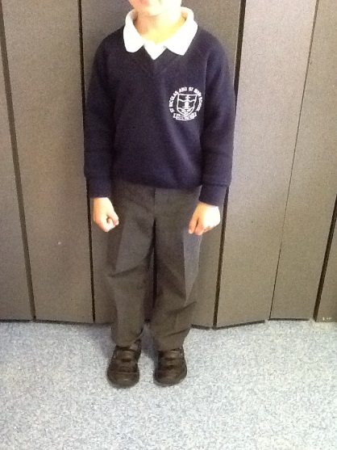
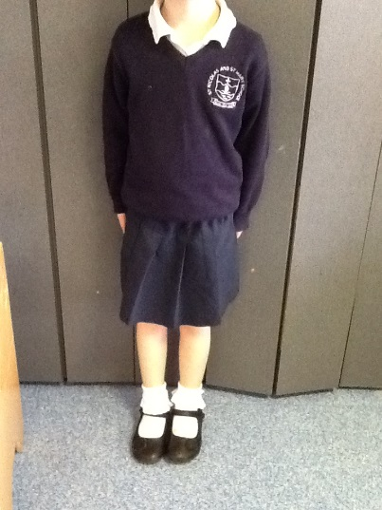
School Uniform

Slide 5
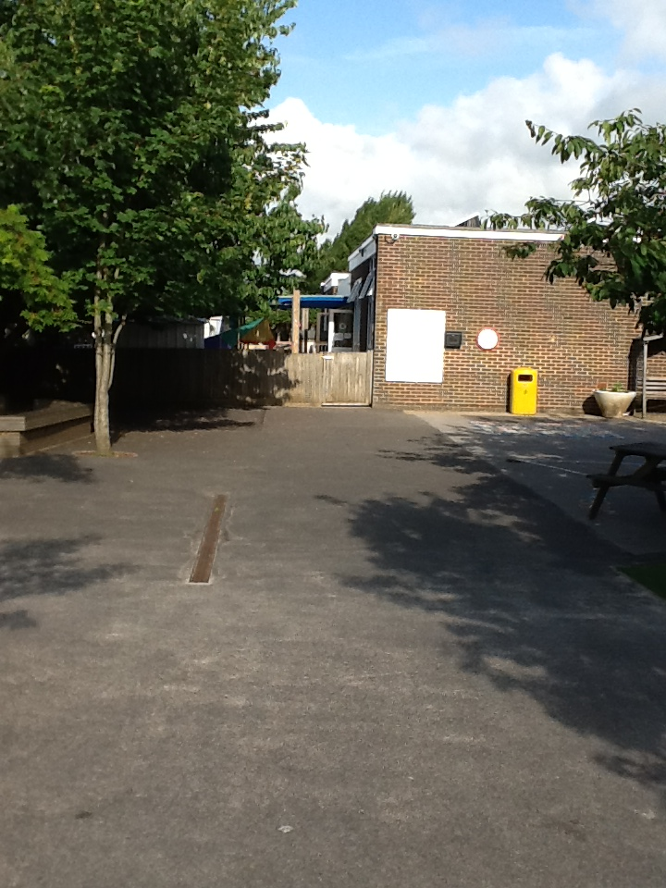
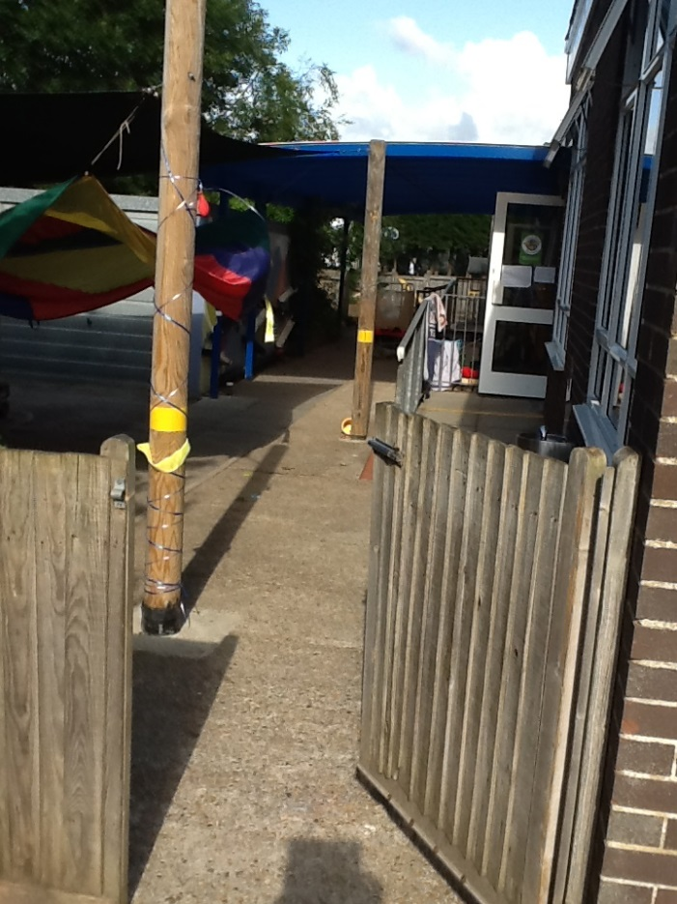
This is how I will come into school in the mornings.
Into the outside area.
Through the gate and across the playground.

Slide 6
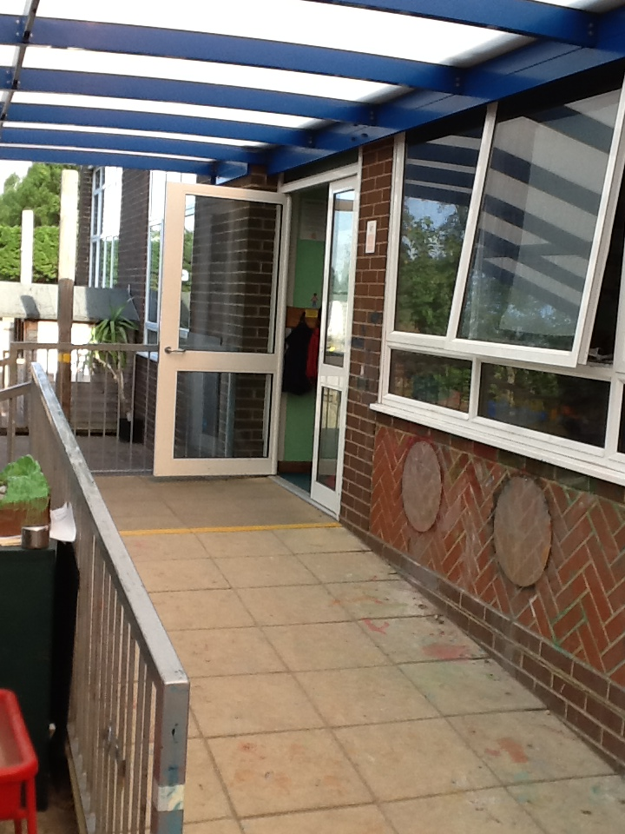
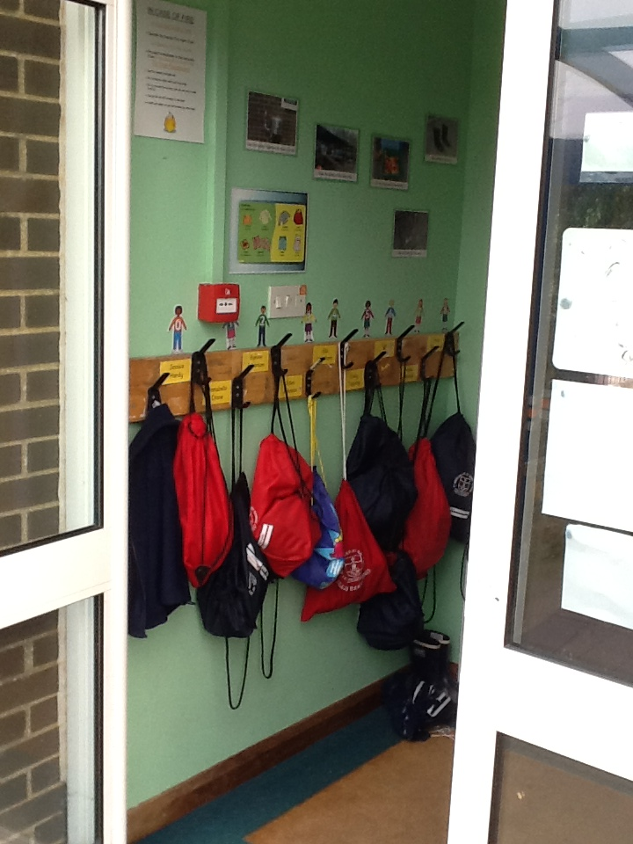
I go up the ramp and… then I’m in my classroom!

Slide 7
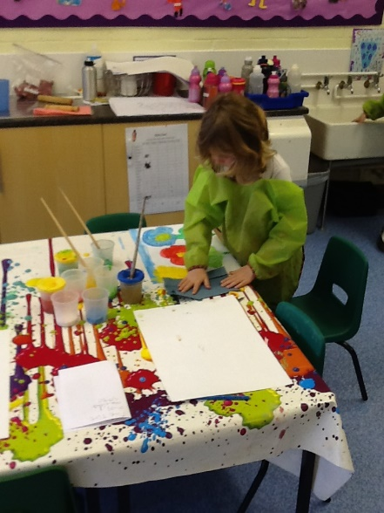
There are lots of fun things to do in my classroom.

Slide 8
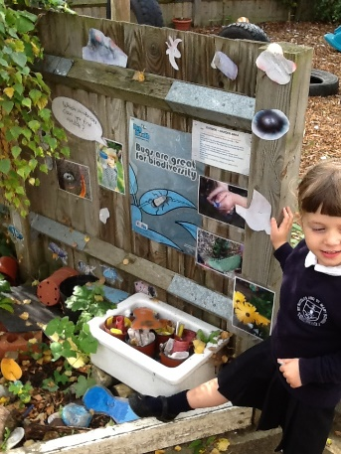
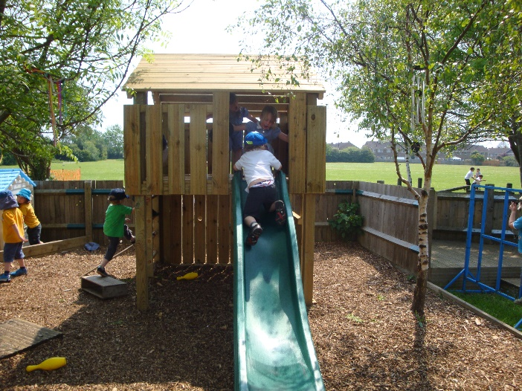
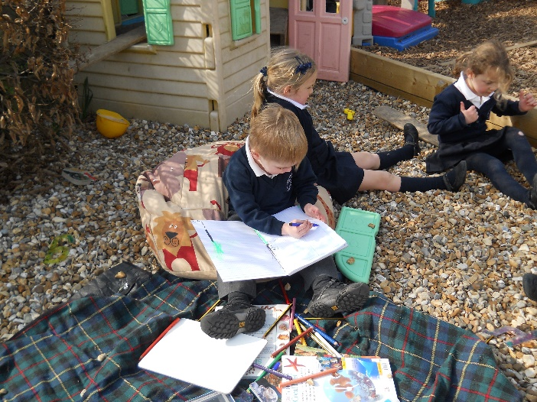
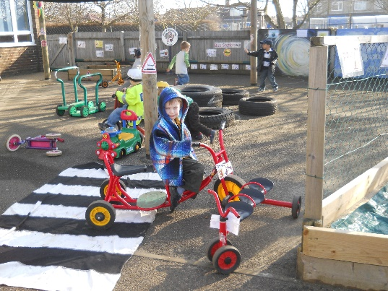
Sometimes I can play in the outside area.

Slide 9
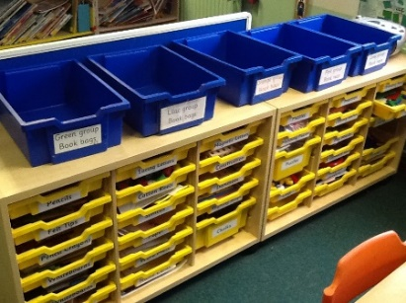
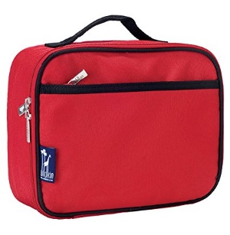


My jobs to do in the morning
You put your book bag in the animal boxes every day.
You put your water bottle
in the boxes provided.
Blue Whales put their lunch boxes on the shelf below their pegs. Gray Whales put them in a clear box.
When you take reading books home in October you need to change them at least once a week and put them in your book bag.

Slide 10
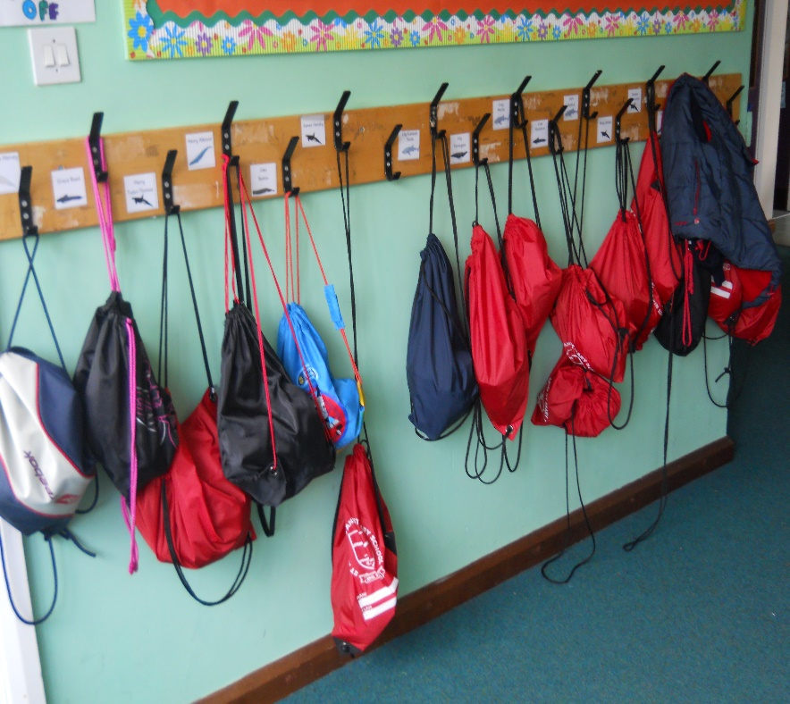
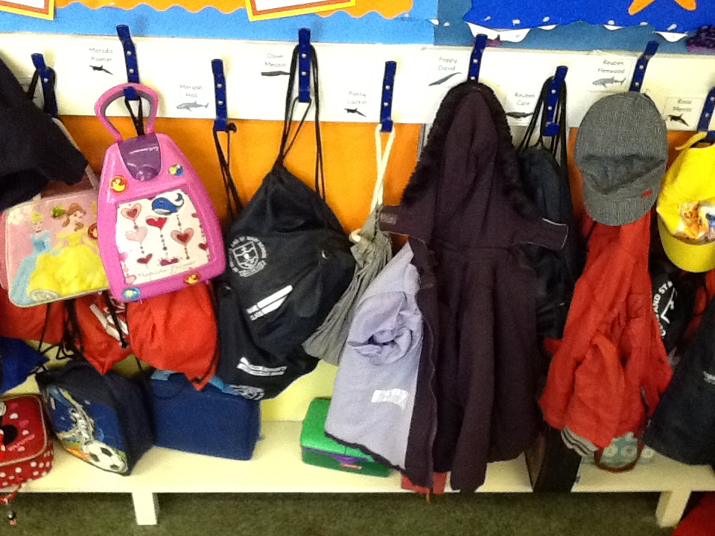
Where I hang up my coat and PE Kit
Gray Whale Class Blue Whale Class

Slide 11
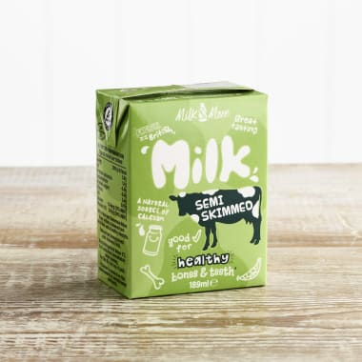
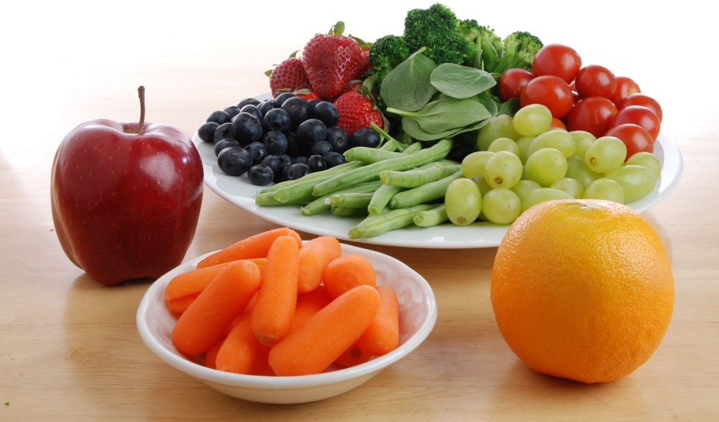
Snack Time
We have access to fruit and milk every day.
Please remember to bring in your named water bottles.
We have different fruit or vegetable each day
including carrots, raisins, apples, tomatoes, bananas
and pears.

Slide 12
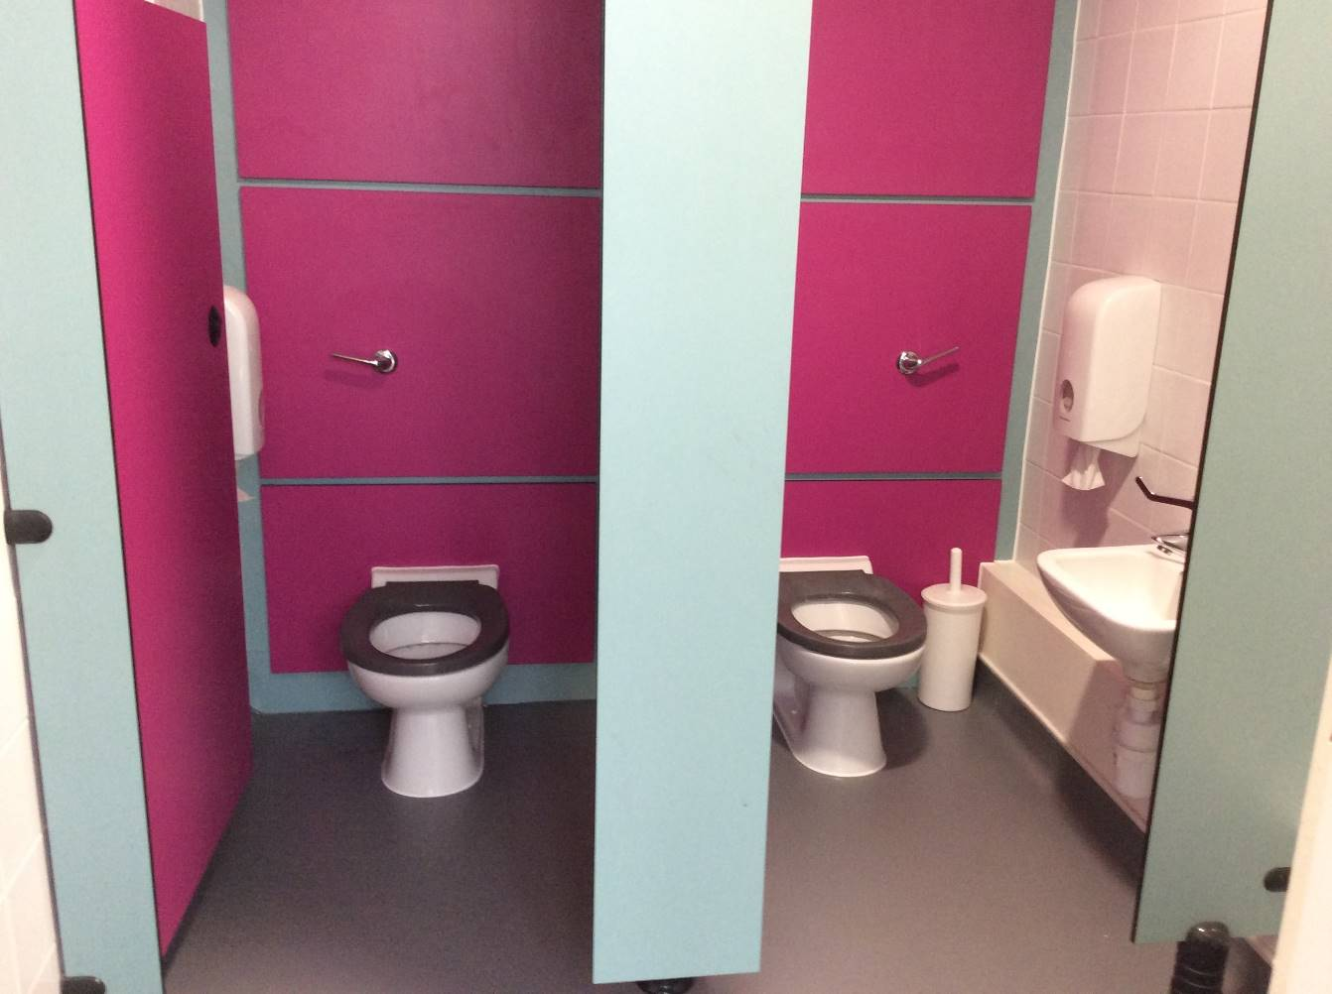
Toilets
We have a toilet in each classroom that you can use anytime throughout the day.

Slide 13
We hope you have a fantastic summer and we look forward to meeting and getting to know you in September.

