Slide 1
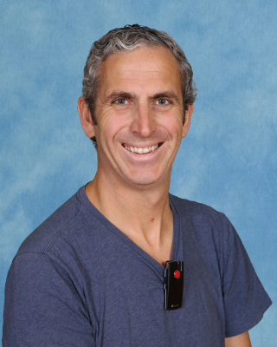
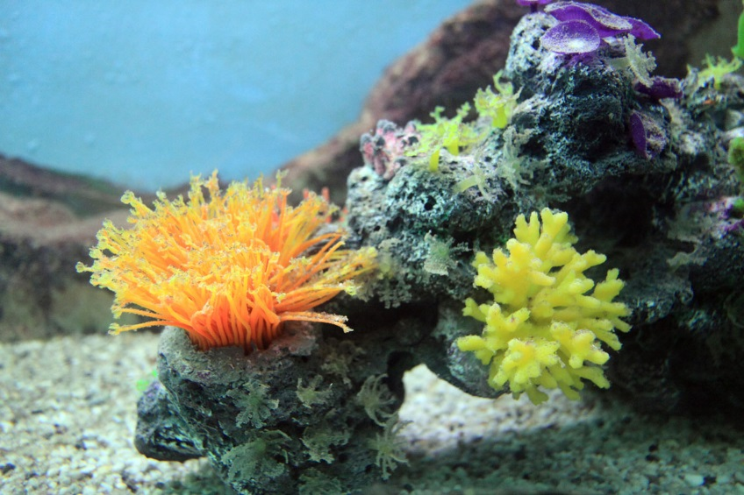
This is my new teacher
I am going to Year 6 Coral Class
Mr de Waal

Slide 2
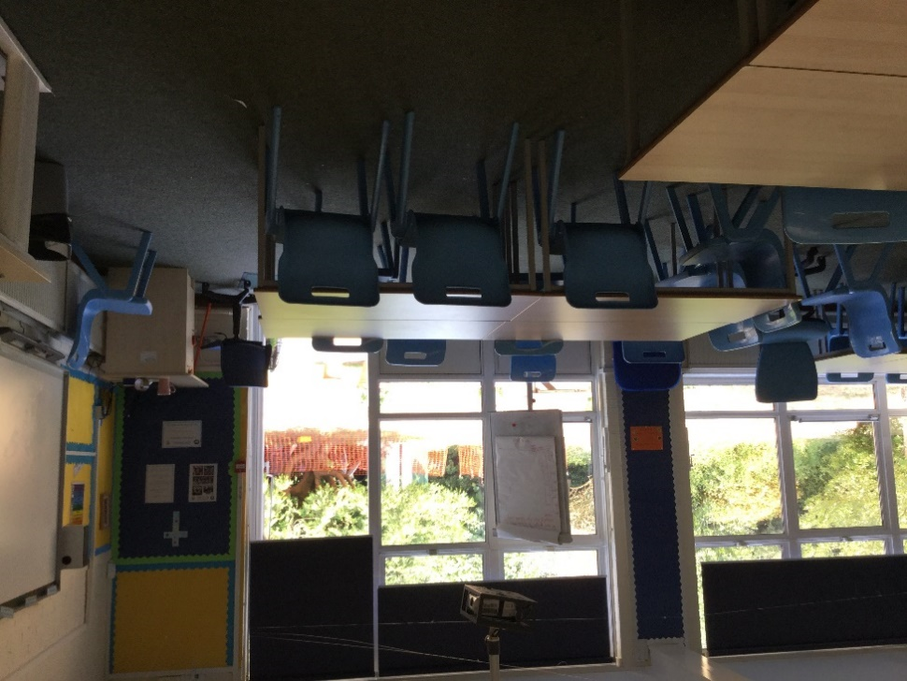
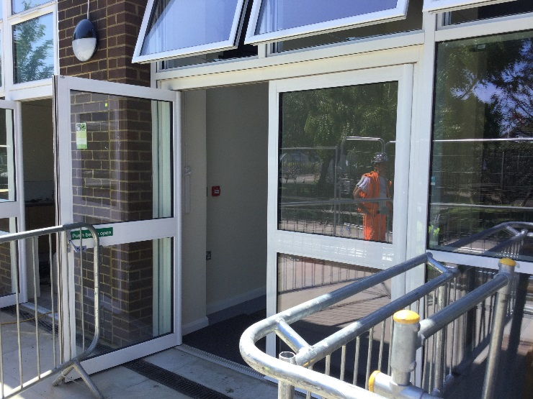
This is where I will come into school
This will be my new classroom

Slide 3
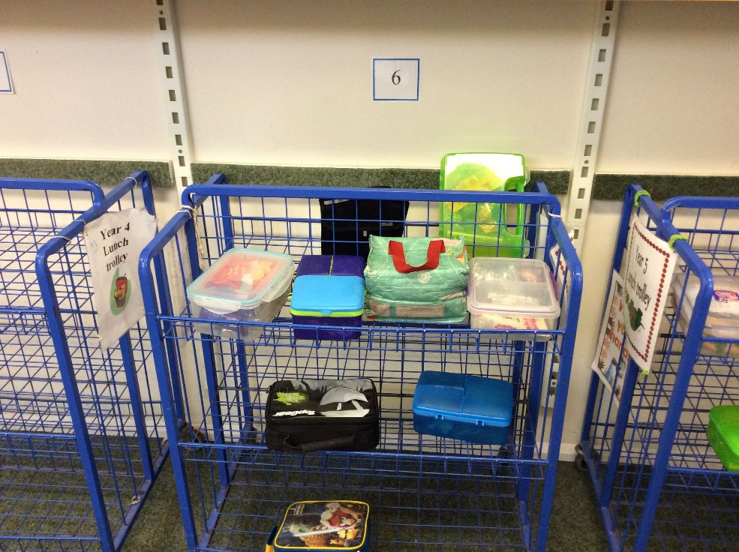
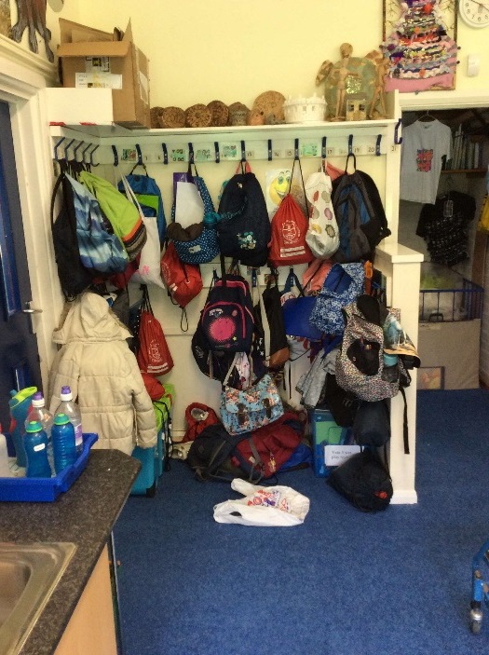
This is where I will hang my coat
This is where I will put my lunch

Slide 4
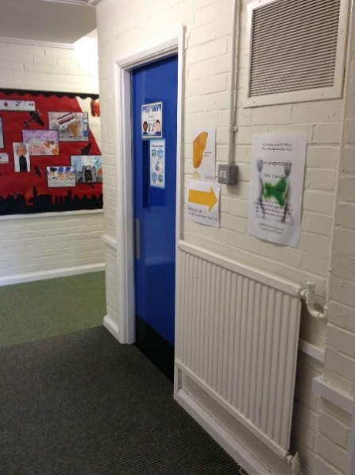
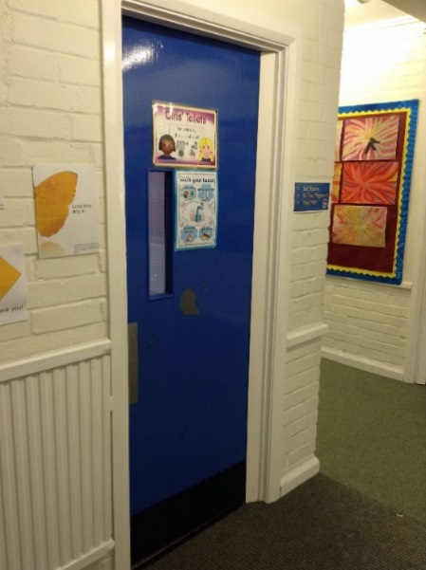
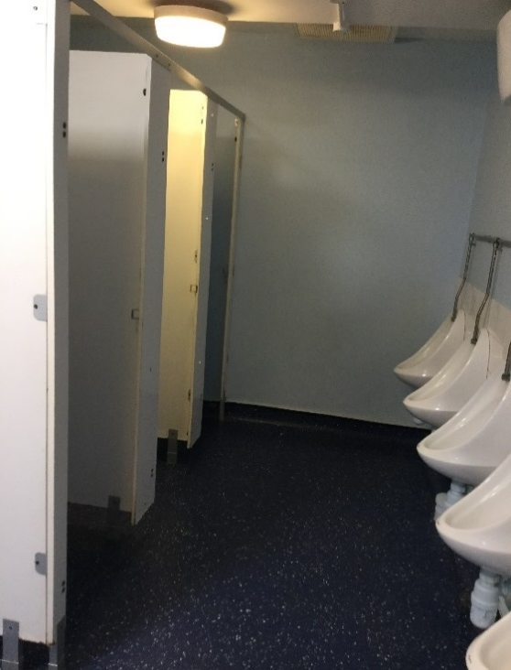
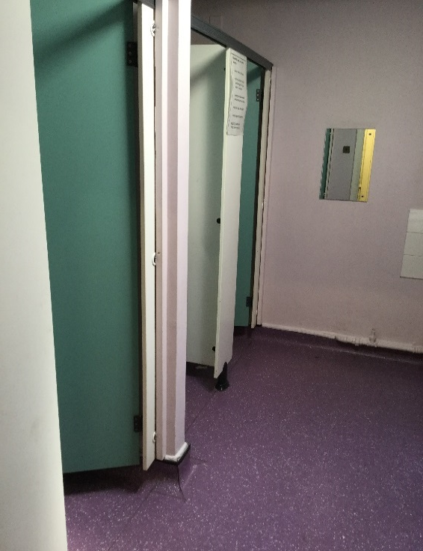
These are the toilets I will use

Slide 5
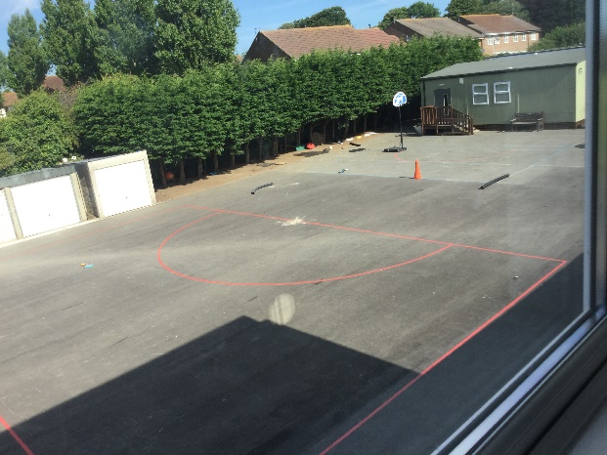


This is my new playground
I will eat my lunch at 12:00
Fir Tree Playground

Slide 6
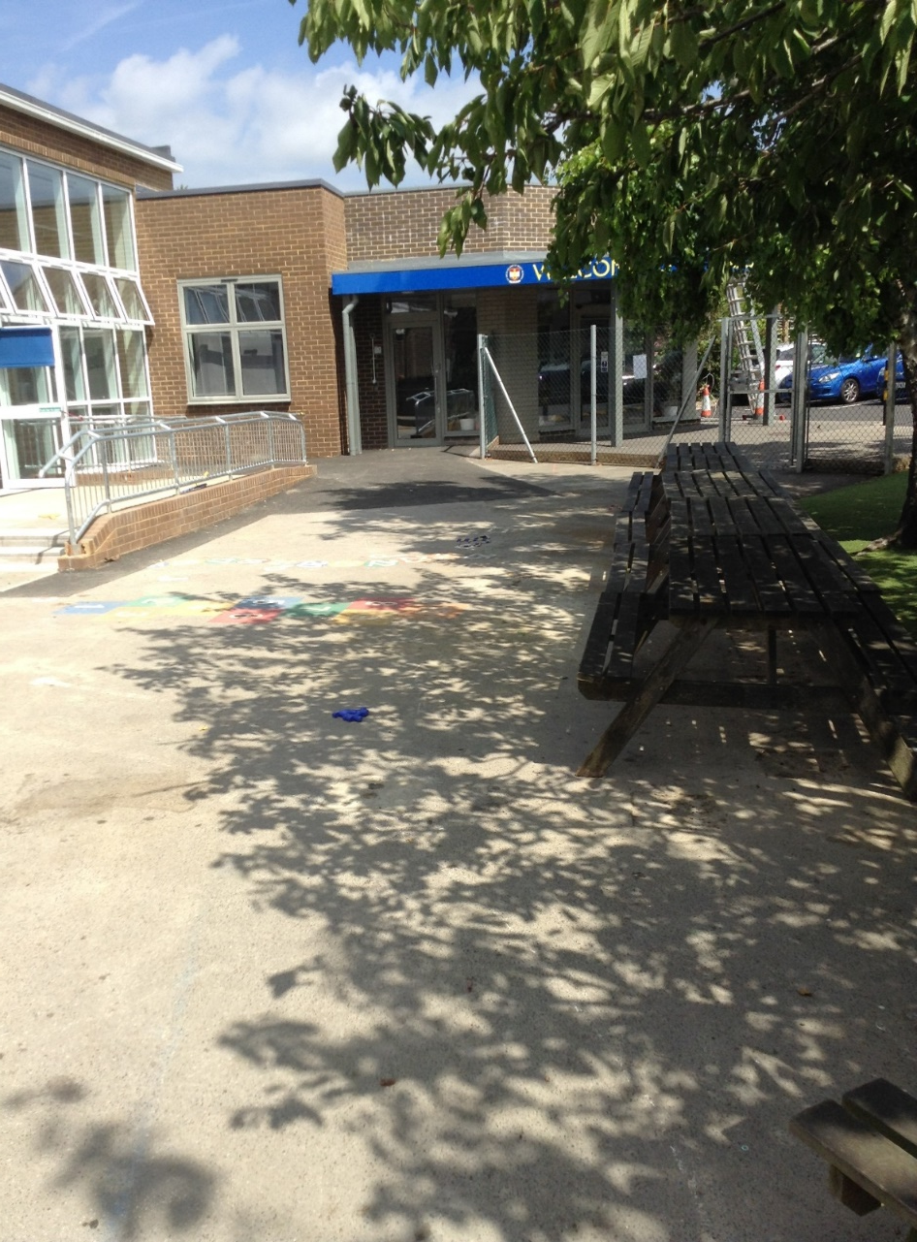
This is where I will be picked up from after school.

Slide 7


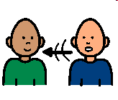

Everyone feels nervous and maybe excited when they are starting something new.
It is ok to ask questions.
It is ok to not know what to do all the time.

Slide 8



Your teacher and teaching assistant will help you. You can ask them for help or ask them a question if you are unsure about something.
You will soon settle in and enjoy the new things that you do.
Soon it will seem like an ‘old’ classroom not a new one!!

Slide 9

Well done!
You are on the way to being ready for the next school year! Fantastic!

