Slide 1

VISION
Be Courageous! Live and Learn in Faith, Hope and Love

Slide 2
VISION
Milestone events which have contributed to the new vision

Slide 3

Milestone events which have contributed to the new vision
November 2019- Vision Statement
Our most recent vision statement approved by governors
Key Elements/terms:
•Beacon of excellence (linked to our work as a leading light)
•Collaboration (outreach through senior leadership support/secondments and academy exploration)
•Inspirational, Innovative, Inclusive (fundamental corner stones of the school curriculum)
•Respectful, resourceful, resilient and reflective (linked to Building learning Power)
•Compassion and hope (identified key Christian values)
April 2021- Empowerment Approach
Introduction of the Empowerment Approach into school. Adopting a research based approach to supporting children with behaviour and anxiety.
https://www.changingchances.co.uk/empowerment-approach/

Slide 4
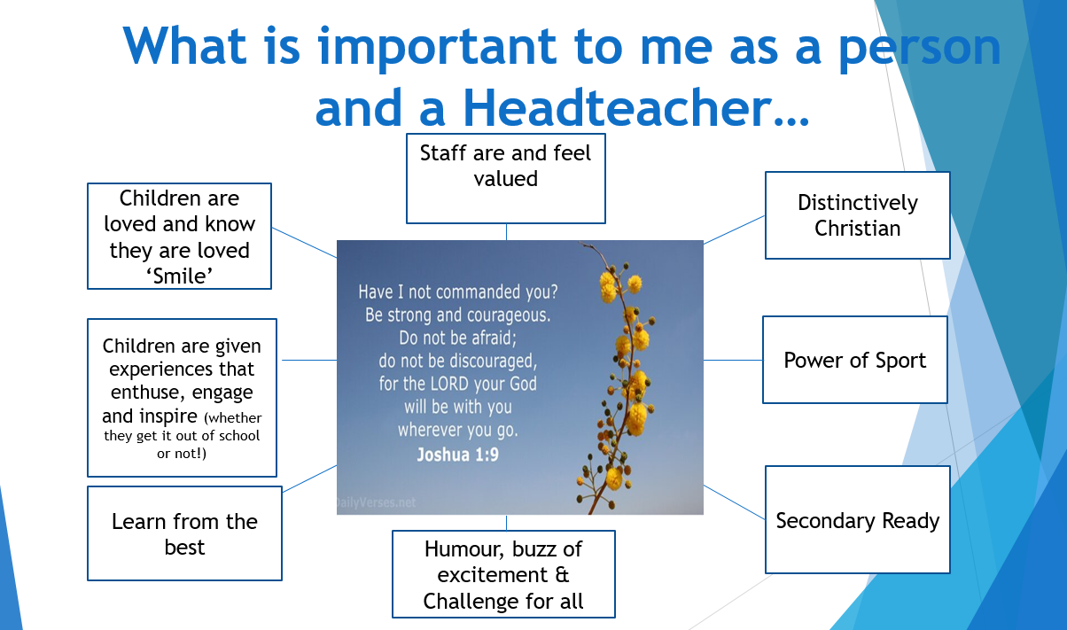
Milestone events which have contributed to the new vision
May 2021- Headteacher Philosophy (What is important?)
Joshua 1:9 is at the heart of my philosophy as a leader at St Nicolas and St Marys.
‘Courage coming from knowing God is always with us’
Key Phrases:
‘Children are loved’,
‘Children are inspired’
‘Staff feel valued’ and ‘Challenge for all’
March 2023- Annual Parent Survey
Parents were asked: ‘In three words describe what St Nicolas and St Marys Primary School means to you and your family.’
Key words that came up very frequently-: Nurture, care and love.

Slide 5

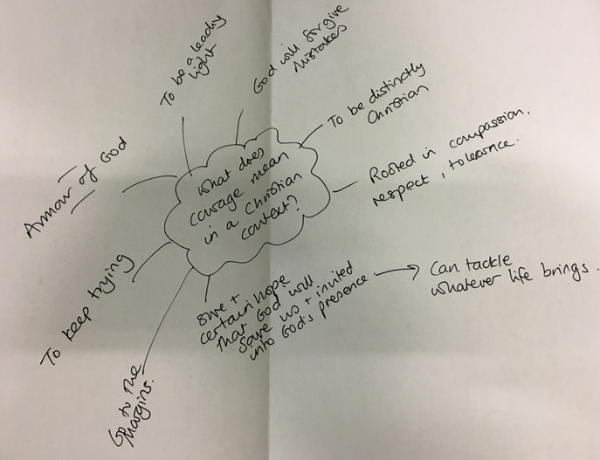
April 2023- Governor working party
Time spent with small group of governors.
The challenge was to take a step back and focus on: What does courage mean in a Christian context?
‘Armour of God’
‘Assurance through faith’
‘Keep trying’
‘Mistakes are forgiven’
June 2023- Staff and Parent views- Staff meetings and parent survey
What is courage?
How can we be a courageous school?
’ Taking risks’
‘Bold and confident’
‘Being brave’
‘trying new ideas’
‘willing to make mistakes- overcome fear’
’High expectations’
‘Demonstrate our talents in and out of school’
‘Try new things’
‘Go out of our comfort zones’
‘Accept challenges’
‘Innovative thinking’

Slide 6





Slide 7
Vision 2023
Courage
Faith
Inspiration
Innovation
Inclusion
Hope
Love

Slide 8



Vision statement- 2023
Be Courageous! In God’s faith, hope and love empowered to be Inspirational, Innovative and Inclusive.
Following feedback from staff and children it was felt that the vision should focus on the theological underpinning that comes from Joshua 1:9 and 1 Corinthians 13:13. Therefore a review of the vision statement concluded with an updated statement for 2024.

Slide 9
Vision statement- 2024
Be Courageous! Live and Learn in Faith, Hope and Love

Slide 10


